Slide 1

Summer Reading Challenges
You have three reading challenges that you can choose from!
You can complete these challenges on paper at home, print the challenges off from here, or collect a paper copy of the challenges from the library before Friday 19th July
What Can You Win?
10 reading recognition points to start the new year!
A sweet treat.
A Friday lunch and breaktime 'queue jumper' to bypass the queue in the food hall.
A priority pass to the library for a whole week.

Slide 2
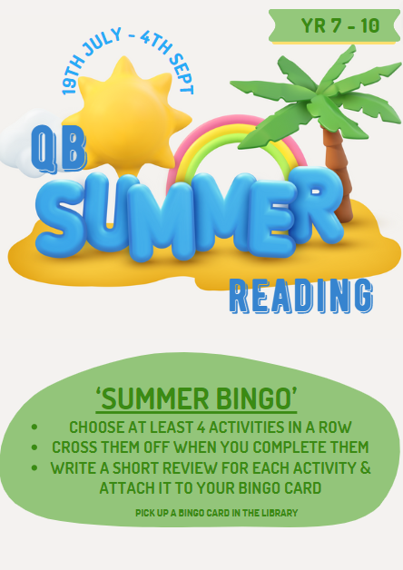
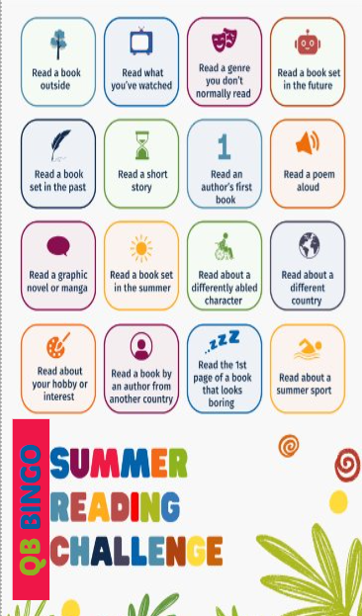
CHALLENGE 1

Slide 3

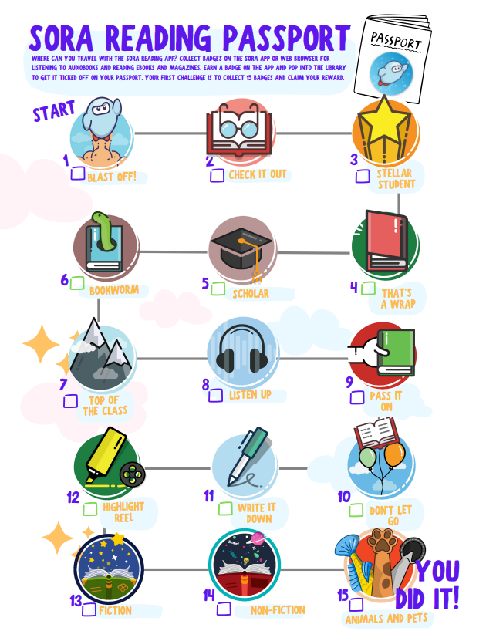
Challenge 2
Collect a passport from the library or print your own copy off on the next slide.

Slide 4
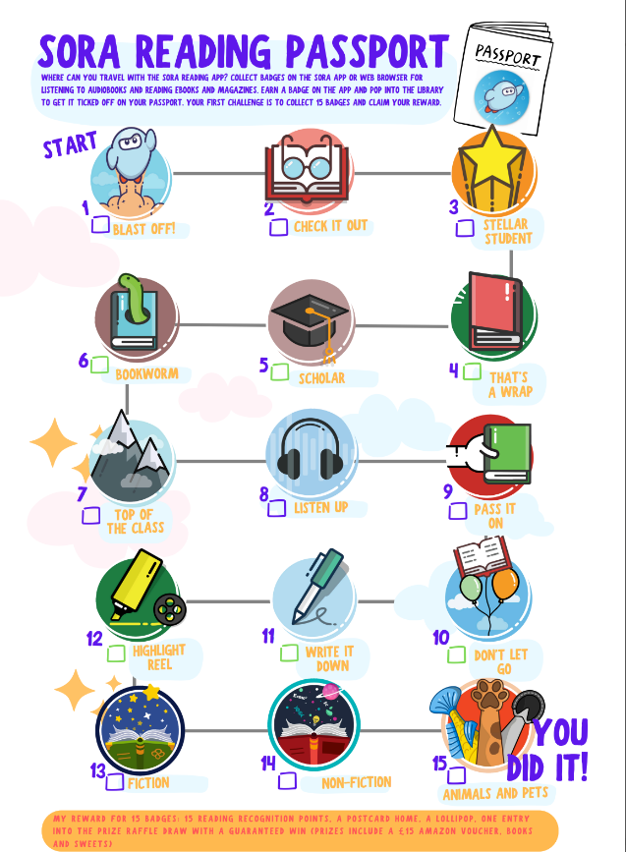
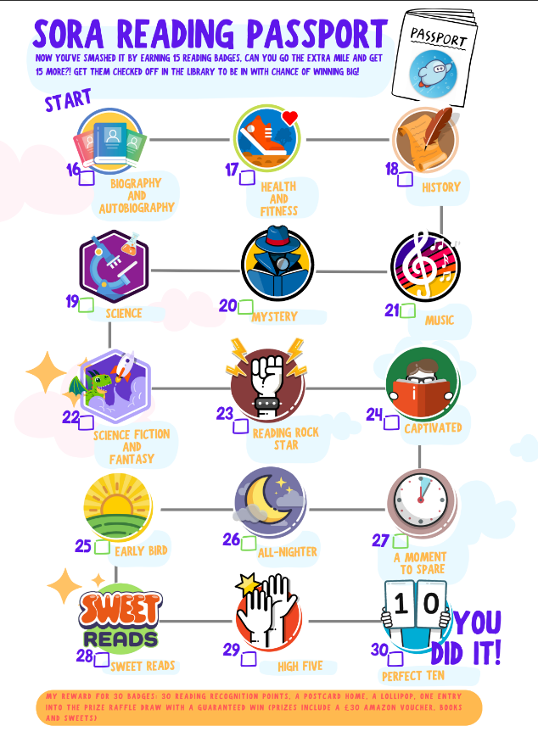

Slide 5
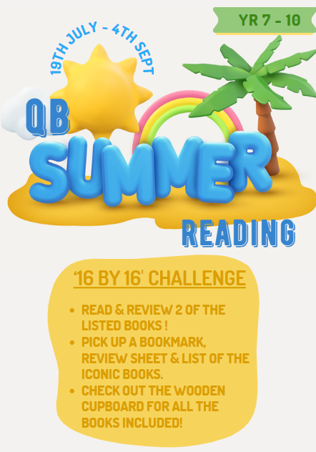

Challenge 3
This is the big one! A signed letter of recommendation from our Headteacher and the Reading Lead if you read 16 of these books by the time you're 16! This will impress colleges and future employers.

